Slide 1
Monitoring and Feedback Loop
Pravin Y Pawar
Adapted from “Introducing MLOps”
By Treveil et al

Slide 2
Model monitoring
Model monitoring is a crucial step in the ML model life cycle and a critical piece of MLOps
When a machine learning model is deployed in production
it can start degrading in quality fast—and without warning—until it’s too late
Machine learning models need to be monitored at two levels:
At the resource level, including ensuring the model is running correctly in the production environment.
Key questions include:
Is the system alive?
Are the CPU, RAM, network usage, and disk space as expected?
Are requests being processed at the expected rate?
At the performance level, meaning monitoring the pertinence of the model over time
Key questions include:
Is the model still an accurate representation of the pattern of new incoming data?
Is it performing as well as it did during the design phase?

Slide 3
Model performance monitoring
The first level is a traditional DevOps topic
The latter is more complicated. Why?
Because how well a model performs is a reflection of the data used to train it
in particular, how representative that training data is of the live request data
As the world is constantly changing,
a static model cannot catch up with new patterns that are emerging and evolving without a constant source of new data
Model performance monitoring attempts to track this degradation,
At an appropriate time, it will also trigger the retraining of the model with more representative data

Slide 4
Model Retraining
Critical for organizations to have a clear idea of deployed models’ drift and accuracy
by setting up a process that allows for easy monitoring and notifications
Ideal scenario would be a pipeline that automatically triggers checks for degradation of model performance
goal of notifications is not necessarily to kick off an automated process of retraining, validation, and deployment
but to alert the data scientist of the change; to diagnose the issue and evaluate the next course of action
Critical that as part of MLOps and the ML model life cycle,
data scientists and their managers and the organization as a whole understand model degradation
Every deployed model should come with monitoring metrics and corresponding warning thresholds
to detect meaningful business performance drops as quickly as possible

Slide 5
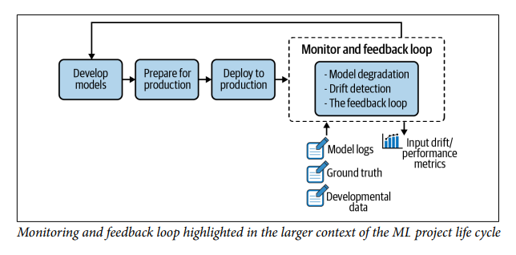
Monitoring and feedback loop

Slide 6
Model Degradation
Once a machine learning model is trained and deployed in production
Two approaches to monitor its performance degradation:
ground truth evaluation
input drift detection

Slide 7
Ground Truth Evaluation
Defined
Ground truth retraining requires waiting for the label event
In a fraud detection model, the ground truth would be whether or not a specific transaction was actually fraudulent
For a recommendation engine, it would be whether or not the customer clicked on—or ultimately bought—one of the recommended products
With the new ground truth collected,
next step is to compute the performance of model based on ground truth
compare it with registered metrics in the training phase
When the difference surpasses a threshold, the model can be deemed as outdated, and it should be retrained
The metrics to be monitored can be of two varieties:
Statistical metrics like accuracy, ROC AUC, log loss, etc.
domain agnostic
drawback is that the drop may be statistically significant without having any noticeable impact
cost of retraining and risk associated with a redeployment may be higher than expected benefits
Business metrics, like cost-benefit assessment such as the credit scoring
far more interesting because they ordinarily have a monetary value
enabling subject matter experts to better handle the cost-benefit trade-off of the retraining decision

Slide 8
Ground Truth Evaluation(2)
Challenges
Ground truth is not always immediately, or even imminently, available
For some types of models, teams need to wait months (or longer) for ground truth labels to be available,
which can mean significant economic loss if the model is degrading quickly
Deploying a model for which the drift is faster than the lag is risky
Ground truth and prediction are decoupled
To compute the performance of the deployed model on new data, it’s necessary to be able to match ground truth with the corresponding observation
In many production environments, this is a challenging task because these two pieces of information are generated and stored in different systems and at different timestamps
Ground truth is only partially available
In some situations, it is extremely expensive to retrieve the ground truth for all the observations,
which means choosing which samples to label and thus inadvertently introducing bias into the system

Slide 9
Input Drift
Mathematically speaking, the samples of each dataset cannot be assumed to be drawn from the same distribution
i.e., they are not “identically distributed”
Another mathematical property is necessary to ensure that ML algorithms perform as expected: independence
property is broken if samples are duplicated in the dataset or if it is possible to forecast the “next” sample given the previous one
If train the algorithm on the first dataset and then deploy it on the second one
The resulting distribution shift is called a drift
In wine quality prediction exercise,
Called a feature drift
if the alcohol level is one of the features used by the ML model
or if the alcohol level is correlated with other features used by the model
Called as a concept drift if it is not

Slide 10
Drift Detection in Practice
To be able to react in a timely manner, model behavior should be monitored solely based on the feature values of the incoming data,
without waiting for the ground truth to be available
The logic is that if the data distribution (e.g., mean, sd, correlations between features) diverges
between the training and testing phases on one side and the development phase on the other,
a strong signal that the model’s performance won’t be the same!
Not the perfect mitigation measure, as retraining on the drifted dataset will not be an option,
but it can be part of mitigation measures (e.g., reverting to a simpler model, reweighting)

Slide 11
Causes of Data Drift
Two frequent root causes of data drift
Sample selection bias
the training sample is not representative of the population
often stems from the data collection pipeline itself
For instance, building a model to assess the effectiveness of a discount program will be biased
if the best discounts are proposed for the best clients
Non-stationary environment
where training data collected from the source population does not represent the target population
Often happens for time dependent tasks — such as forecasting with strong seasonality effects,
where learning a model over a given month won’t generalize to another month

Slide 12
Input Drift Detection Techniques
Choice depends on the expected level of interpretability
Two approaches
Univariate statistical tests
Domain classifier
Should prefer univariate statistical tests
Organizations that need proven and explainable methods
Domain classifier approach may be a good option
if complex drift involving several features simultaneously is expected
if the data scientists want to reuse what they already know and assuming the organization doesn’t dread the black box effect

Slide 13
Univariate statistical tests
Requires applying a statistical test on data from the source distribution and the target distribution for each feature
A warning will be raised when the results of those tests are significant
Basic approaches rely on two tests:
For continuous features, the Kolmogorov-Smirnov test is a nonparametric hypothesis test that is used to check whether two
samples come from the same distribution
For categorical features, the Chi-squared test is a practical choice that checks whether the observed frequencies
for a categorical feature in the target datamatch the expected frequencies seen from the source data
The main advantage of p-values is that they help detect drift as quickly as possible
The main drawback is that they do not quantify the level of the effect
If development datasets are very large, it is necessary to complement p-values with business-significant metrics
For example, on a sufficiently large dataset, the average age may have significantly drifted from a statistical perspective,
but if the drift is only a few months, this is probably an insignificant value for many business use cases

Slide 14
Domain classifier
Data scientists train a model that tries to discriminate between the original dataset (input features and, optionally, predicted target) and the development dataset
stack the two datasets and train a classifier that aims at predicting the data’s origin
The performance of the model (its accuracy, for example) can then be considered as a metric for the drift level
If this model is successful in its task, and thus has a high drift score,
implies that the data used at training time and the new data can be distinguished
fair to say that the new data has drifted
To gain more insights, in particular to identify the features that are responsible for the drift
one can use the feature importance of the trained model

Slide 15
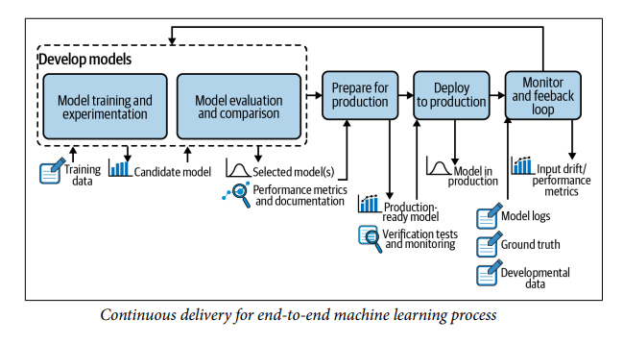
Continuous delivery for end-to-end machine learning process

Slide 16
The Feedback Loop
All effective machine learning projects implement a form of data feedback loop
information from the production environment flows back to the model prototyping environment for further improvement
Continuous delivery for end-to-end machine learning process
Data collected in the monitoring and feedback loop is sent to the model development phase
From there, the system analyzes whether the model is working as expected
If it is, no action is required
If the model’s performance is degrading, an update will be triggered, either automatically or manually by the data scientist
In practice, usually means either retraining the model with new labeled data or developing a new model with additional features

Slide 17
The Feedback Loop(2)
Goal of retraining is to be able to capture the emerging patterns and make sure that the business is not
negatively impacted
This infrastructure is comprised of three main components, which are critical to robust MLOps capabilities:
A logging system that collects data from several production servers
A model evaluation store that does versioning and evaluation between different model versions
An online system that does model comparison on production environments,
either with the shadow scoring (champion/challenger) setup or with A/B testing

Slide 18
Logging
Monitoring a live system means collecting and aggregating data about its states
Nowadays, as production infrastructures are getting more and more complex,
with several models deployed simultaneously across several servers,
an effective logging system is more important than ever!
Data from these environments needs to be centralized to be analyzed and monitored,
either automatically or manually
will enable continuous improvement of the ML system
An event log of a machine learning system is a record with a timestamp and information such as
Model metadata - Identification of the model and the version
Model inputs - Feature values of new observations
Model outputs - Predictions made by the model that
System action - an action taken based on model prediction
Model explanation - an explanation of prediction (i.e., which features have the most influence on the prediction

Slide 19
Model Evaluation
If model performance is degrading, after review, data scientists decide to improve the model by retraining it,
With several trained candidate models, the next step is to compare them with the deployed model
means evaluating all the models (the candidates as well as the deployed model) on the same dataset
If one of the candidate models outperforms the deployed model, there are two ways to proceed:
either update the model on the production environment
or move to an online evaluation via a champion/challenger or A/B testing setup
In a nutshell, this is the notion of model store
A structure that allows data scientists to:
Compare multiple, newly trained model versions against existing deployed versions
Compare completely new models against versions of other models on labeled data
Track model performance over time

Slide 20
Model evaluation store
Formally, the model evaluation store serves as a structure that centralizes the data related to model life cycle to allow comparisons
Two main tasks of a model evaluation store are:
Versioning the evolution of a logical model through time
Each logged version of the logical model must come with all the essential information concerning its training phase, including:
The list of features used
The preprocessing techniques that are applied to each feature
The algorithm used, along with the chosen hyperparameters
The training dataset
The test dataset used to evaluate the trained model (this is necessary for the version comparison phase)
Evaluation metrics
Comparing the performance between different versions of a logical model

Slide 21
Online Evaluation
Online evaluation of models in production is critical from a business perspective,
but can be challenging from a technical perspective
Two main modes of online evaluation:
Champion/challenger (otherwise known as shadow testing)
the candidate model shadows the deployed model and scores the same live requests
A/B testing
the candidate model scores a portion of the live requests and the deployed model scores the others
Both cases require ground truth
evaluation will necessarily take longer than the lag between prediction and ground truth obtention
Whenever shadow testing is possible, it should be used over A/B testing
because it is far simpler to understand and set up, and it detects differences more quickly

Slide 22
Thank You!
In our next session:

